Slide 1
International Digital University
azamat.giniiatullin@studenti.unitn.it
gaia.pizzuti@studenti.unitn.it
riccardo.germenia@studenti.unitn.it

Slide 2
Purpose definition
CQ3: What are the research areas that have seen the most collaboration between the two universities?
CQ12: Which students are pursuing a PhD
in Data Science?
Dr. Maria Rossi
Prof. Bat Erdene
(Researcher)
(Lecturer)
Personas
(Ph.D. Student)
(Research administrator)
Lisa Bianchi
Dr. Enkhtuul Tserendorj
CQ8: What is the
academic profile (publications, projects) of a particular researcher from either university?
CQ11: What are the
deliverables and deadlines for specific ongoing projects between the two universities?
Notes:
different roles present in a research institution

Slide 3
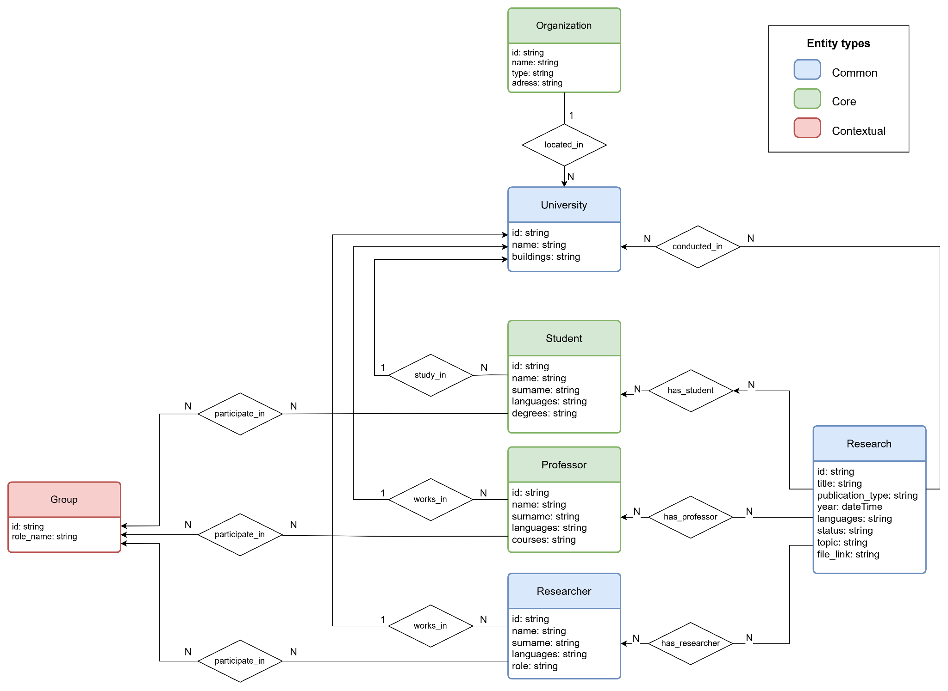
ER Model

Slide 4


Information Gathering
Data Scientia Foundation
UniTN's Website
Publications
Staff
Organizations
Projects
Language resources

Slide 5
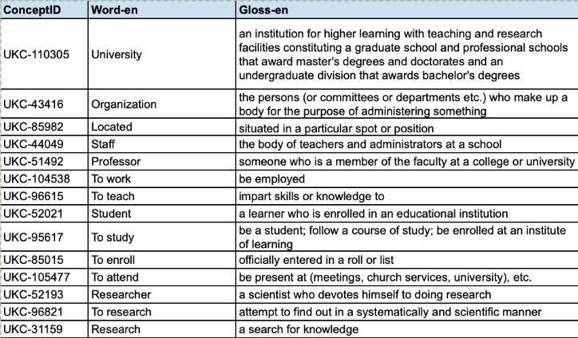
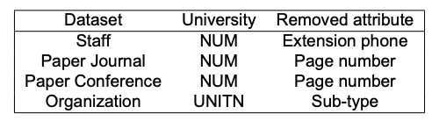
Language definition
Aim: to formalize the concepts and resources required for the KG
Concept identification
Dataset filtering
Concept-spreadsheet
Heterogeneity resolution
Concept selection: etypes, data and object properties
UKC alignment
115 concepts: 103 already defined (UKC-n) and 12 defined by us (KGE24-12-n)
Translation : italian and mongolian
Resolve inconsistency between collected datasets
Use of concept spreadsheet to align UNITN and NUM datasets

Slide 6
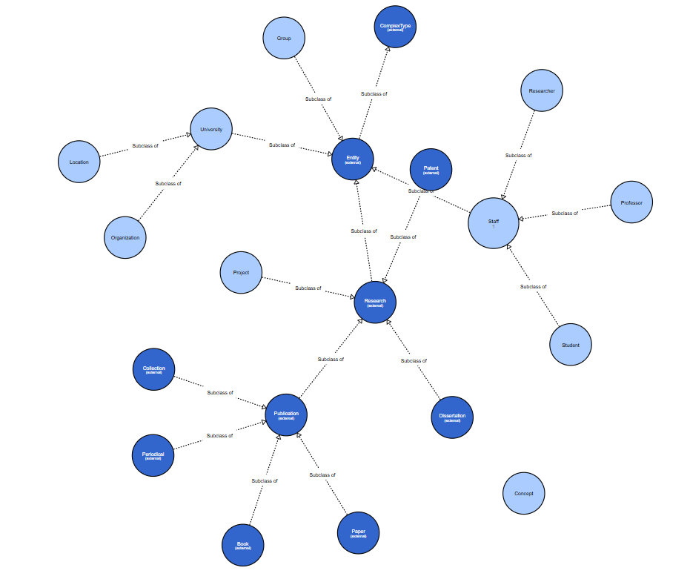
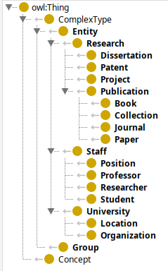
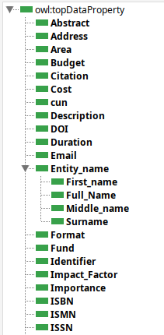
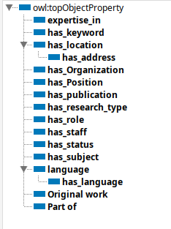
Knowledge definition
Formalization of conceptual and structural representation of KG
Classes
Data properties
Object properties
Teleology
Visualization created with WebOWL

Slide 7




Evaluation of the Knowledge layer
Coverage of Competency Questions
Coverage of Reference Ontology
Formulas displayed using https://editor.codecogs.com/

Slide 8

Thanks
Project’s repository:

